Slide 1
MODULE IV
INTELLIGENT BUILDING AND GREEN BUILDING
Notes:
‹#›

Slide 2
Intelligent building
An intelligent building is one that integrates various systems (lighting, heating, air conditioning, voice and data communication and other building functions) to effectively manage resources in a coordinated mode so as to maximize occupant performance, savings and flexibility & minimize investment and operating cost
Notes:
‹#›

Slide 3
Intelligent building
An intelligent building is one in which the building fabric, space, service and information systems can respond in an efficient manner to the initial and changing demands of the owner, the occupier and be in harmony with environment
Intelligent building combines innovations, technology, with skilful management to maximize returns on investments
Notes:
‹#›

Slide 4
Intelligent building
An intelligent building system concept considers that the true cost of the building is not its cost of construction, it must include the operating and maintenance costs over its life span.
Cost reductions can be achieved by optimizing energy use through automated control, communication and management systems
Notes:
‹#›

Slide 5
Features Expected in intelligent building
High speed fibre optic communication network trunk for data, video and building administrative system
Flexible HVAC system
Lighting, Fire Alarm and other building supporting systems
Dedicated circuit power distribution network with UPS
Standby power generation
Notes:
‹#›

Slide 6
INTELLIGENT BUILDING MODEL
Divided in to 7 systems
1.Heating,Ventilating and Air Conditioning (HVAC) system
2.Electrical power distribution system
3.Communication system
4.Lighting system
5.Vertical Transport system
6.Security system
7.Life safety system
Notes:
‹#›

Slide 7
What is Green Building?
It is a new approach to save water, energy and material resources in the construction and maintenance of the buildings and can reduce or eliminate the adverse impact of building on the environment and occupants
Notes:
‹#›

Slide 8
What is Green Building?
EPA definition: “Green or sustainable building is the practice of creating healthier and more resource-efficient models of construction, renovation, operation, maintenance, and demolition.”
More than just installing solar panels on your roof
Notes:
‹#›

Slide 9
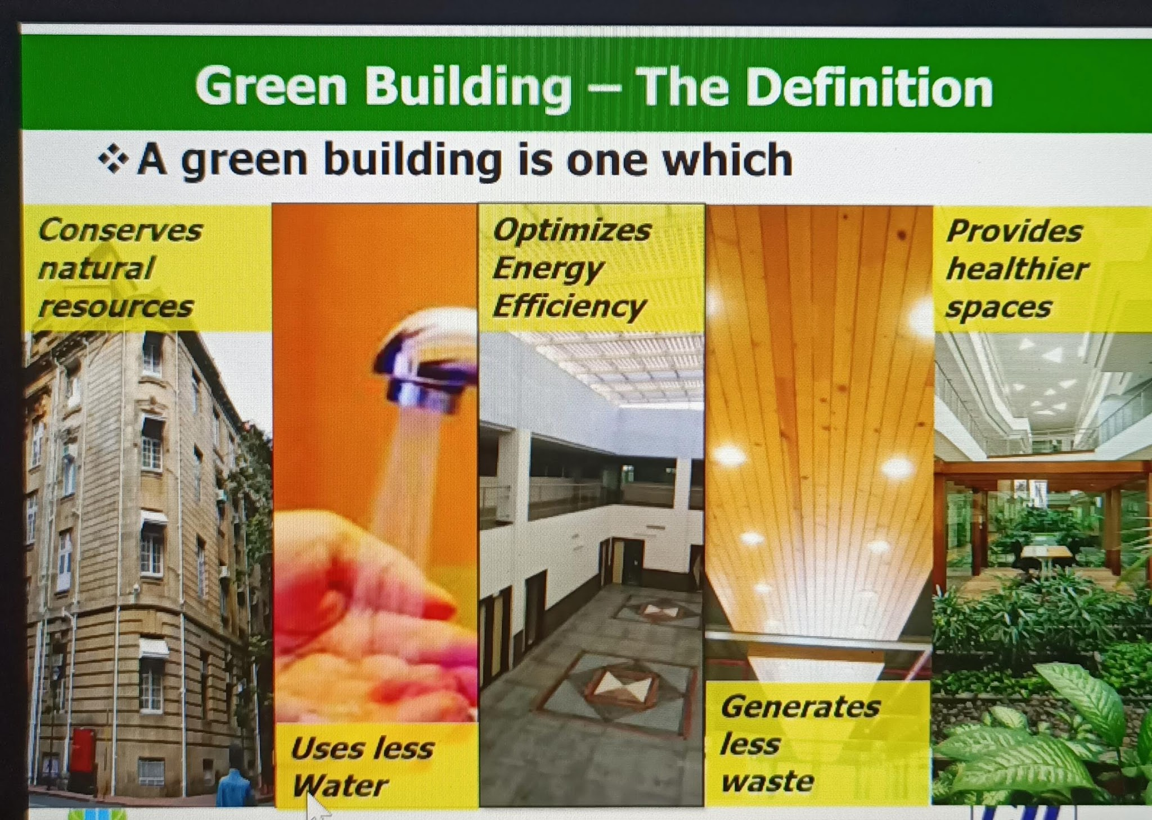

Slide 10
GREEN BUILDING
Green buildings are Eco Friendly Structures . This helps the earth and people to retain nature to the maximum extent possible in 3 ways with reference to the location of buildings
1.Retain the external environment at the location of the building( land, water, energy)
2.Improve internal environment for the inhabitants(light, air)
3. Preserve the environment at places far away from the building(locally available materials green building materials)
Notes:
‹#›

Slide 11
New Project Planning
Construction – Reduce the amount of waste generated at a construction site
Design – Building design details will help to reduce construction materials, and energy/water requirements when completed
Material Selection – Careful selection of construction materials will leave less of an environmental impact
Notes:
‹#›

Slide 12
New Project Planning-Construction
Construction waste accounts for 10 to as much as 30% of municipal waste
Goal: Reduce / Reuse / Recycle
Building design based on standard sizes of materials
Buy higher quality to reduce rejects
Recycle (use scraps)
Renovate an existing building
Notes:
‹#›

Slide 13
New Project Planning- Building Design
Goal: To design the building so that it requires less energy/water and is healthier for inhabitants when it is complete and in use.
Air ducts for an efficient and healthy air flow
Insulation
Windows designed for maximum daylight
Solar Control
Solar Cells
Location
Notes:
‹#›

Slide 14
New Project Planning-Materials
Goal: Choose materials that have low environmental costs and do not contribute to indoor air pollution
Materials which could be recycled and reclaimed
Doors and Windows (energy and placement)
Floor Coverings.
Roof Materials (Reflective and light)
Energy Efficient Appliances
Notes:
‹#›

Slide 15
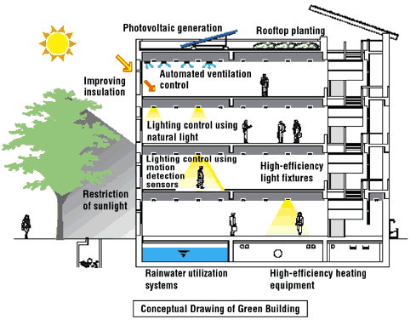
Notes:
‹#›

Slide 16
Obstacles
93% of consumers worry about their home’s environmental performance. However, only 18% are willing to pay more to reduce the impact.
There are higher initial costs for Green Building
Customers are concerned that they would be sacrificing comfort
Notes:
‹#›

Slide 17
Support for Green Building
Green building constructed should confirm to the prescribed standards.
There should be continuous assessment and monitoring from the planning up to the completion of construction , for declaring a building as a green building
Notes:
‹#›
‹#›

Slide 18
LEED green building rating system
LEED (Leadership in Energy and Environmental Design)Green Building Rating system
In India, IGBC – Indian Green Building Council
Points are awarded for adopting Green concepts in various categories and the buildings are certified Green at levels such as Silver, Gold or Platinum based on the total number of points they get in LEED Rating
Notes:
‹#›

Slide 19
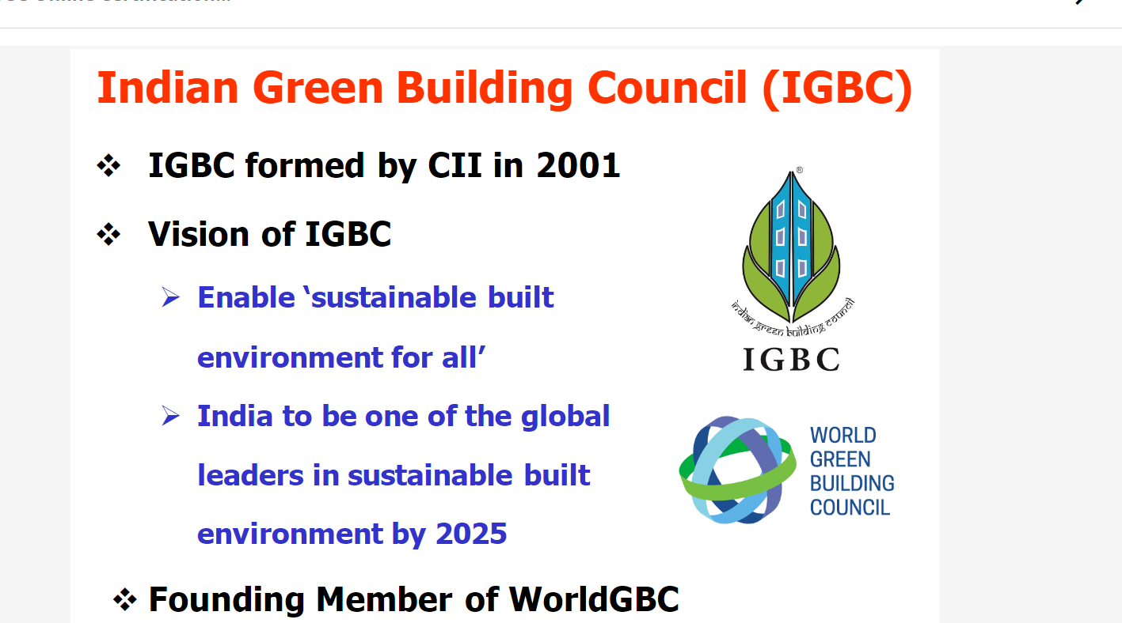

Slide 20
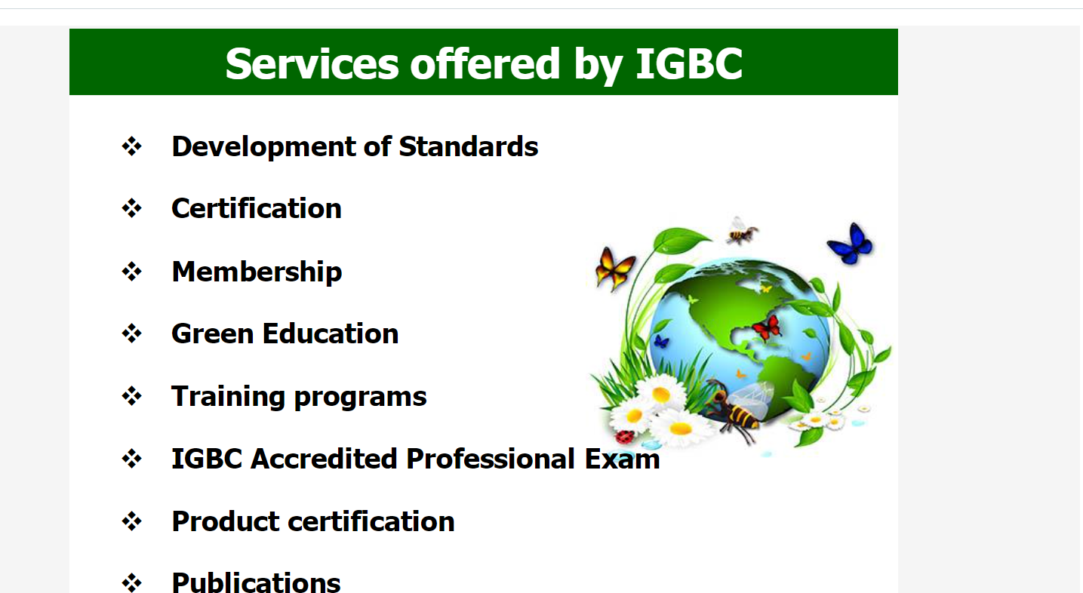

Slide 21
Green Building Standards
LEED – Leadership in Energy and Environmental Design
Administered by the U. S. Green Building Council
Voluntary, consensus-based system
Notes:
‹#›

Slide 22
LEED Basics – Why LEED?
The “built environment” accounts for approximately:
40% of global consumption of raw materials
37% of primary U. S. energy consumption (operations)
68% of U. S. electricity consumption
12% of U. S. potable water consumption
40% of U. S. sold waste stream
35% of U. S. carbon dioxide emissions
Notes:
‹#›

Slide 23
LEED Basics – Why LEED?
Advertised as:
Reducing environmental impact
Reducing operating costs
Increasing occupant comfort and productivity
Other potential benefits:
Higher rents?
Higher sales price?
Notes:
‹#›

Slide 24
LEED Basics – Rating Systems
New Construction
Existing Buildings: O&M
Commercial Interiors
Core and Shell
Schools
Homes
Notes:
‹#›

Slide 25
LEED Basics – Rating System Example (LEED 2009-NC)
Category | Prerequisites | Credits | Possible points
Sustainable Sites (SS) | 1 | 8 | 26
Water Efficiency (WE) | 1 | 3 | 10
Energy & Atmosphere (EA) | 3 | 6 | 35
Materials & Resources (MR) | 1 | 7 | 15
Indoor Environmental Quality (EQ) | 2 | 8 | 15
Innovation & Design Process (ID) | None | 2 | 5
Regional Priority | None | 1 | 4
Totals: | 8 | 35 | 110
Notes:
‹#›

Slide 26
AUDIT FOR GREEN CONCEPT IN BUILDING
CATEGORIES FOR RATING | LEED POINTS
Sustainable site | 13
Water efficiency | 6
Energy and atmosphere | 17
Materials and Resources | 13
Indoor Environment Quality | 15
Design process and innovation | 4
Employing LEED designer | 1
TOTAL POINTS | 69
Notes:
‹#›

Slide 27
LEED Basics – Category Examples
Sustainable Sites (SS)
Site Selection
Density and Connectivity
Brownfield Redevelopment
Alternative Transportation
Site Development – Habitat/Open Space
Stormwater Control
Reduction of “Heat Island” Effect
Light Pollution Reduction
Notes:
‹#›

Slide 28
LEED Basics – Category Examples
Water Efficiency
Water Use Reduction
Water Efficient Landscaping
Innovative Wastewater Technology
Notes:
‹#›

Slide 29
LEED Basics – Category Examples
Energy & Atmosphere (EA)
Energy Efficiency
Renewable Energy
Building Commissioning
Notes:
‹#›

Slide 30
LEED Basics – Category Examples
Materials & Resources (MR)
Building Reuse
Construction Waste Management
Materials Reuse
Recycled Materials
Regional Materials
Rapidly Renewing Materials
Certified Wood
Notes:
‹#›

Slide 31
LEED Basics – Category Examples
Indoor Environmental Quality (EQ)
Ventilation
Low-Emitting Materials
Controllable Systems: Lighting - Thermal
Thermal Comfort
Daylight & Views
Notes:
‹#›

Slide 32
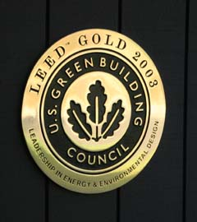
LEED Basics – Certification
Certification is dependent upon number of points earned
Notes:
‹#›

Slide 33
CERTIFICATION FOR GREEN BUILDINGS
LEED Rating Level | Points required
LEED Certified | 26 to 32
Silver Level | 33 to 38
Gold Level | 39 to 51
Platinum Level | 52 and above
Notes:
‹#›
‹#›

Slide 34
EXAMPLES OF GREEN BUILDINGS IN INDIA
LEED Rating Level | Buildings
Silver Level | L&T ERDC, Chennai World Bank, Chennai
Gold Level | Grundfos Pump, Chennai Nucleus Mall, Kochi
Platinum Level | Godrej, Hyderabad ITC , Gurgaon Wipro Technologies, Gurgaon
Notes:
‹#›
‹#›

Slide 35
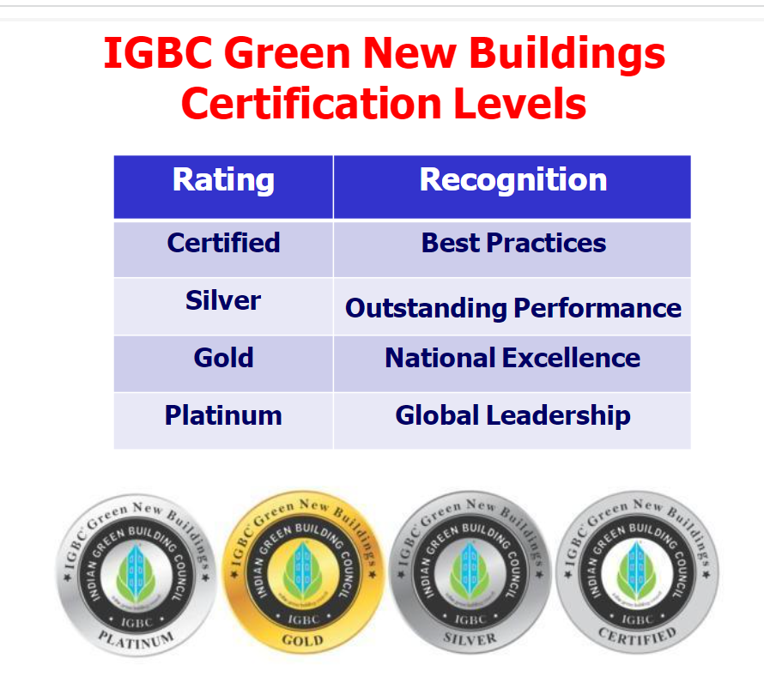

Slide 36
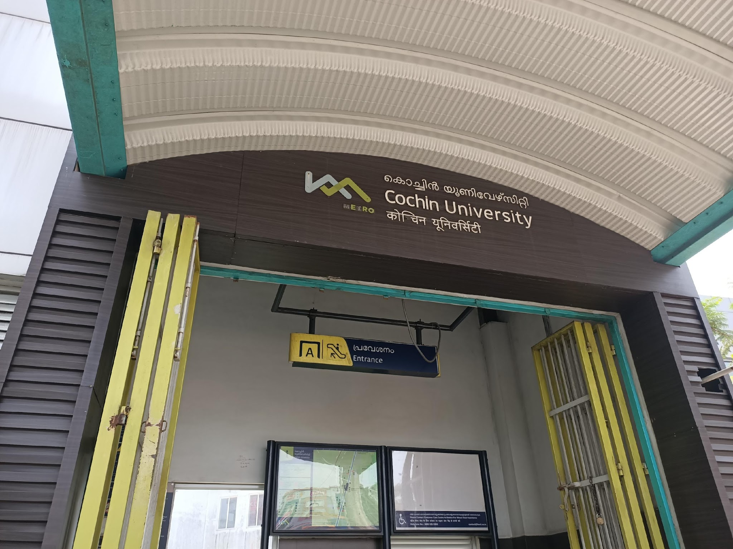

Slide 37
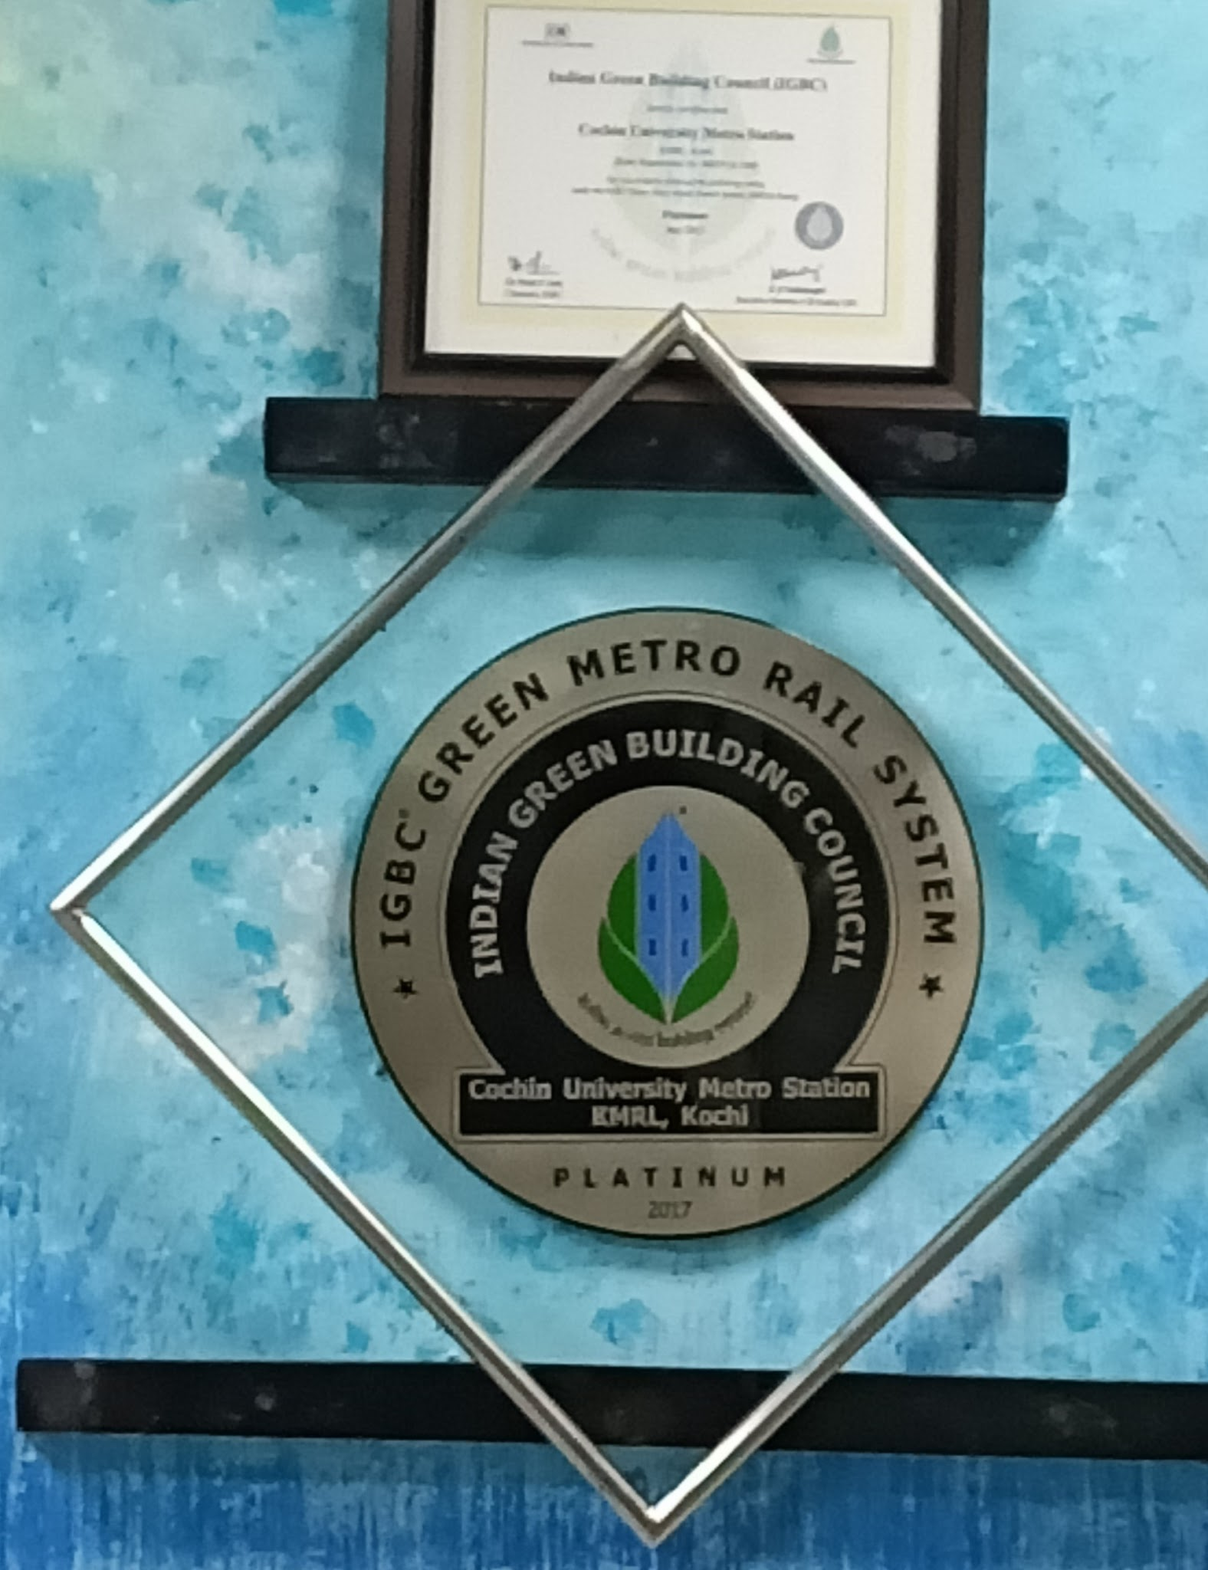

Slide 38
green building - benefits
Energy Savings (20 to 30 %)
Water Savings (30 to 50 %)
Enhanced Air Quality
Excellent Day lighting
Health & Well being of occupants
Conservation of scarce resources
Notes:
‹#›

Slide 39
Conclusion
Now many are thinking about Green buildings and we look forward for a greener future.
Ultimately let us hope that there will be a convergence of Green and Intelligent buildings to provide the best solutions for a safe and ambient work or living area.
Notes:
‹#›

Slide 40
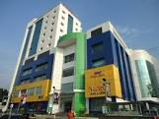
NUCLEUS MALL,KOCHI
Notes:
‹#›

Slide 41
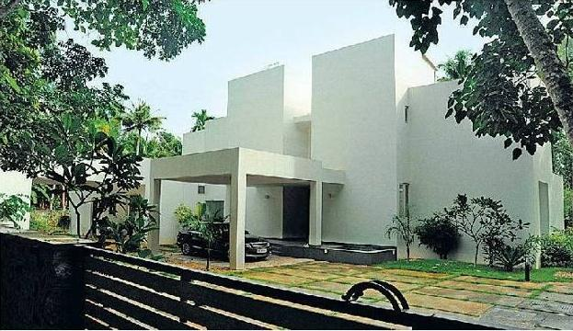
Notes:
‹#›

Slide 42
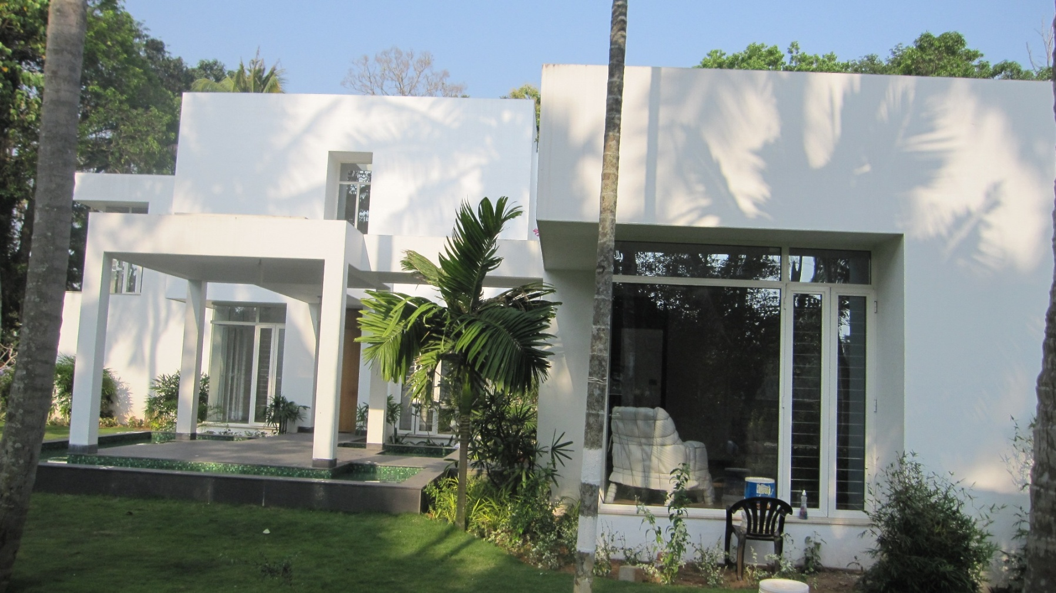
Notes:
‹#›

Slide 43
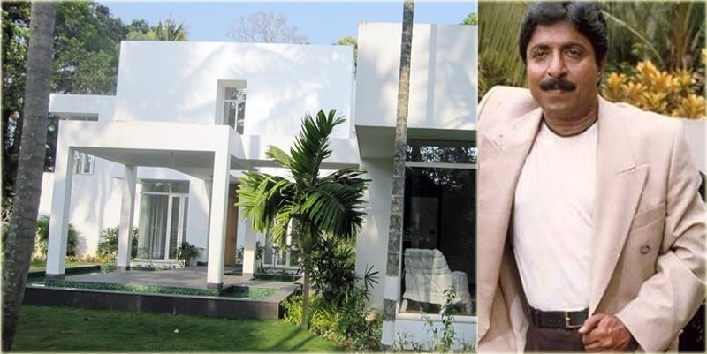
Notes:
‹#›

Slide 44
THANK YOU

